Slide 1

Getting Started With micro:bit and MicroPython
Lesson 2

Slide 2
What the Lesson Will Cover
Getting started with micro:bit and MicroPython
Know what an IDE is
Scroll text on the micro:bit
Display images on the micro:bit
Notes:
Introduce the lesson and what it will cover, Learners could discuss or ask question about what the lesson might involve.

Slide 3
What is an IDE
IDE stands for Integrated Development Environment
It provides ‘tools’ to hep you to code
Common features of an IDE are:
Code editor – this enables you to write your program
Error checker / debugger – this checks your code and highlights errors
Auto complete / code snippets – this provides examples of code or automatically completes your line of code as you are typing it out
Runtime environment – this enables you to run your program and see the output
Notes:
Discuss with Learners the various features of the IDE, they may have used one with other programming languages so can compare the features.
You could compare the IDE with a text editor to highlight the differences.

Slide 4
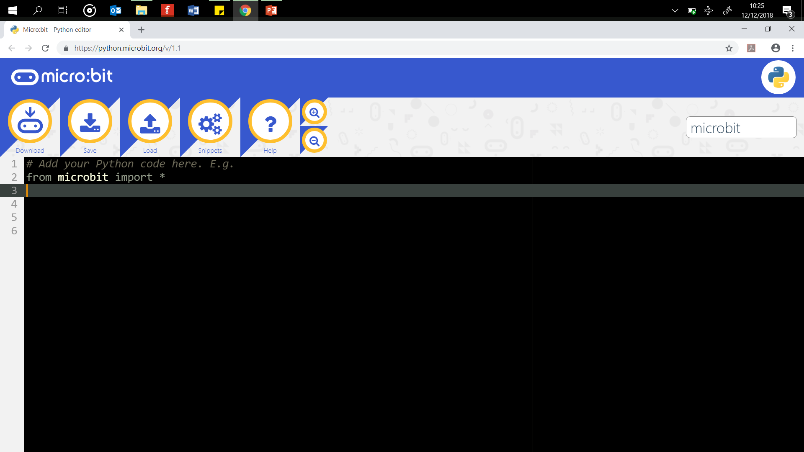
Mu the MicroPython Editor
Notes:
Explain that there are different IDEs for different programming languages, perhaps Learners could find out the names of some for Homework.
Ensuring that MakeCode and Mu are available before you start
Ensure the following website are unfiltered (a constantly updated list is available at https://support.microbit.org/support/solutions/articles/19000030385-firewall-whitelist-requirements-for-micro-bit-editors)
You need access to USB devices if these are blocked by default all Micro:bits use the same ID – use your security policy to exempt the micro:bit ID
PXT / MakeCode/Javascript Blocks Editor:
pxt.microbit.org
makecode.microbit.org
makecode.com www.pxt.io trg-microbit.userpxt.io pxt.azureedge.net
github.com Blocks:
www.microbit.co.uk
Touch Develop:
www.microbit.co.uk
Code Kingdoms:
www.microbit.co.uk
microbit.codekingdoms.com
Python Web Editor (microbit.co.uk)
www.microbit.co.uk
Python Web Editor (microbit.org)
python.microbit.org

Slide 5
Hello World – Writing Your First Program
Open the Mu editor https://python.microbit.org/v/1.1
What do you think lines, 5, 6 and 7 do?
Download the program code to your micro:bit
Did it do what you thought?
Notes:
Hello World is considered the first beginners program, similar to taking your first step as a toddler.
Downloading the code is covered in the Activity Sheet.

Slide 6
Hello World – Make Your Own
# Add your Python code here.
From microbit import *
while True:
display.scroll('Hello, World!')
sleep(2000)
Edit line 3 to create your own message
Can you display two or more messages?
Notes:
Ensure that the indentation levels match, this is the whitespace before the line of code. Usually it is one ‘TAB’ key or ‘four space bar’ presses.
It is important that the level of indentation is consistent for each program. (One TAB or Four spaces)
Indentation also occurs on the next line after the colon : symbol, in the program above, after the while True:
Most errors in the programs will be caused by the indentation levels being incorrect so support students to get them write in these first few programs.

Slide 7
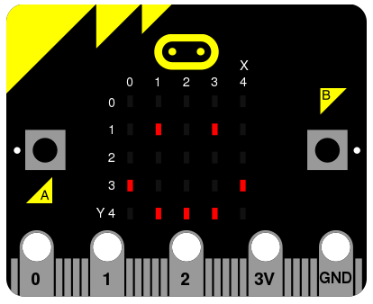
Displaying Images
Notes:
By turning LEDs on and off you can create images, similar to pixels on a screen that can be built up to create images.

Slide 8
Displaying Images
Images are built up by turning the LEDs ON or OFF
There are pre built images which can used
The line of code is display.show(Image.HEART)
Try the program below, download it to your micro:bit and run it:
from microbit import *
while True:
display.show(Image.HEART)
sleep(2000)

Slide 9
Displaying Images – Try Some Of These
Replace the image with one of the pre-made ones:
Image.HEART, Image.HEART_SMALL, Image.HAPPY, Image.SMILE, Image.SAD, Image.CONFUSED, Image.ANGRY, Image.ASLEEP, Image.SURPRISED. Image.SILLY
Image.FABULOUS, Image.MEH. Image.YES, Image.NO, Image.TRIANGLE, Image.CHESSBOARD, Image.DIAMOND, Image.PITCHFORK, Image.XMAS, Image.PACMAN, Image.TARGET
Image.TSHIRT, Image.ROLLERSKATE, Image.DUCK, Image.HOUSE, Image.TORTOISE, Image.BUTTERFLY, Image.STICKFIGURE, Image.GHOST, Image.SWORD, Image.GIRAFFE
Image.SKULL, Image.UMBRELLA, Image.SNAKE
Notes:
Learners can replace the name of the image with some of the ones above, see what happens.

Slide 10
Activity
Use these skills to build a simple message machine
Notes:
Learners work through the activity sheet

